Slide 1

Delivery Time Prediction Project
Enhancing Delivery Efficiency through Data Science
Presented by: K.Swency

Slide 2
INTRODUCTION
Objective: Predict Delivery Time based on Sorting Time.
Context: Improving delivery efficiency is crucial for customer satisfaction and operational optimization.

Slide 3
OBJECTIVE
The primary goal of this project is to predict the delivery time based on the sorting time using a simple linear regression model. The objective is to explore the relationship between sorting time and delivery time, build a predictive model, and draw insights for potential business improvements.

Slide 4
Real-Time Problem
Delivery Time Challenges
Challenge: Inconsistent delivery times impact customer experience and operational planning.
Importance: Timely deliveries contribute to customer satisfaction and loyalty.

Slide 5
SOLUTION
Exploratory Data Analysis (EDA)
Exploratory Data Analysis (EDA) revealed a positive relationship between Sorting Time and Delivery Time.
Scatter Plot:
Visualized the relationship between sorting time and delivery time.
Identified patterns, trends, and potential outliers.
Heatmap:
Analyzed the correlation matrix to understand the strength of the relationship between sorting time and delivery time.

Slide 6
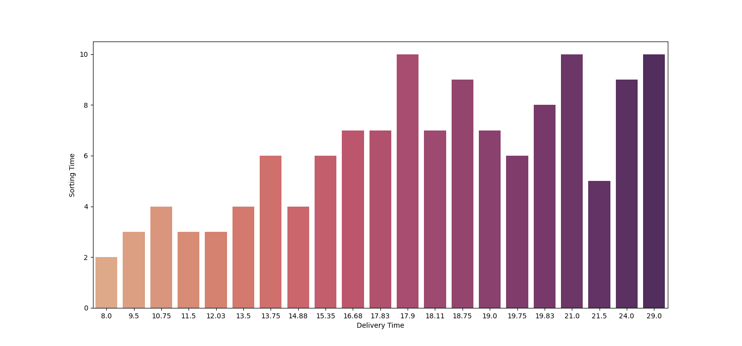
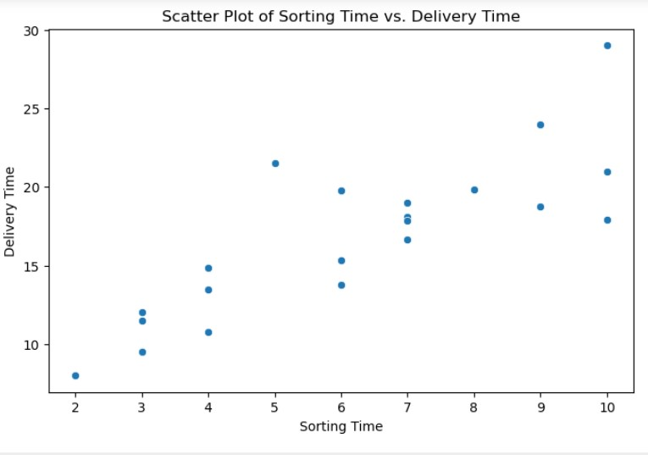
It appears there is a positive linear relationship between Sorting Time and Delivery Time. As Sorting Time increases, Delivery Time tends to increase.

Slide 7
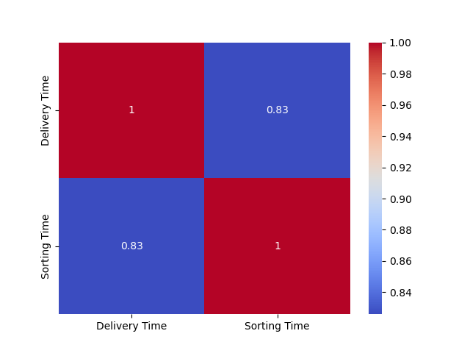
HEAT MAP: Look at the correlation between 'Delivery Time' and 'Sorting Time'. The closer the correlation coefficient is to 1, the stronger the positive correlation.

Slide 8
Business Impact
Improved Delivery Time Estimates:
The model provides a tool for estimating delivery times more accurately based on sorting time.
Optimized Resource Allocation:
Better understanding of the relationship between sorting time and delivery time allows for more effective resource allocation and scheduling
Enhanced Customer Satisfaction:
Accurate delivery time predictions contribute to improved customer satisfaction and loyalty.
Operational Efficiency:
The insights gained from the analysis can be used to streamline operations and optimize delivery processes.

Slide 9
FUTURE CONSIDERATIONS:
Consider expanding the dataset to include more diverse scenarios and factors influencing delivery time.
Regularly update and refine the model based on additional data and changing business dynamics.
Continuous improvement and adaptation to changing business needs are essential for sustained success.

Slide 10
Conclusion
In today's fast-paced and competitive business environment, the accurate prediction of delivery times is crucial for customer satisfaction and operational efficiency. The delivery time prediction project aimed to address this challenge by leveraging data and machine learning.
Embracing a culture of continuous improvement and adapting to real-time feedback will be essential for staying ahead in the dynamic business landscape.

